Slide 1

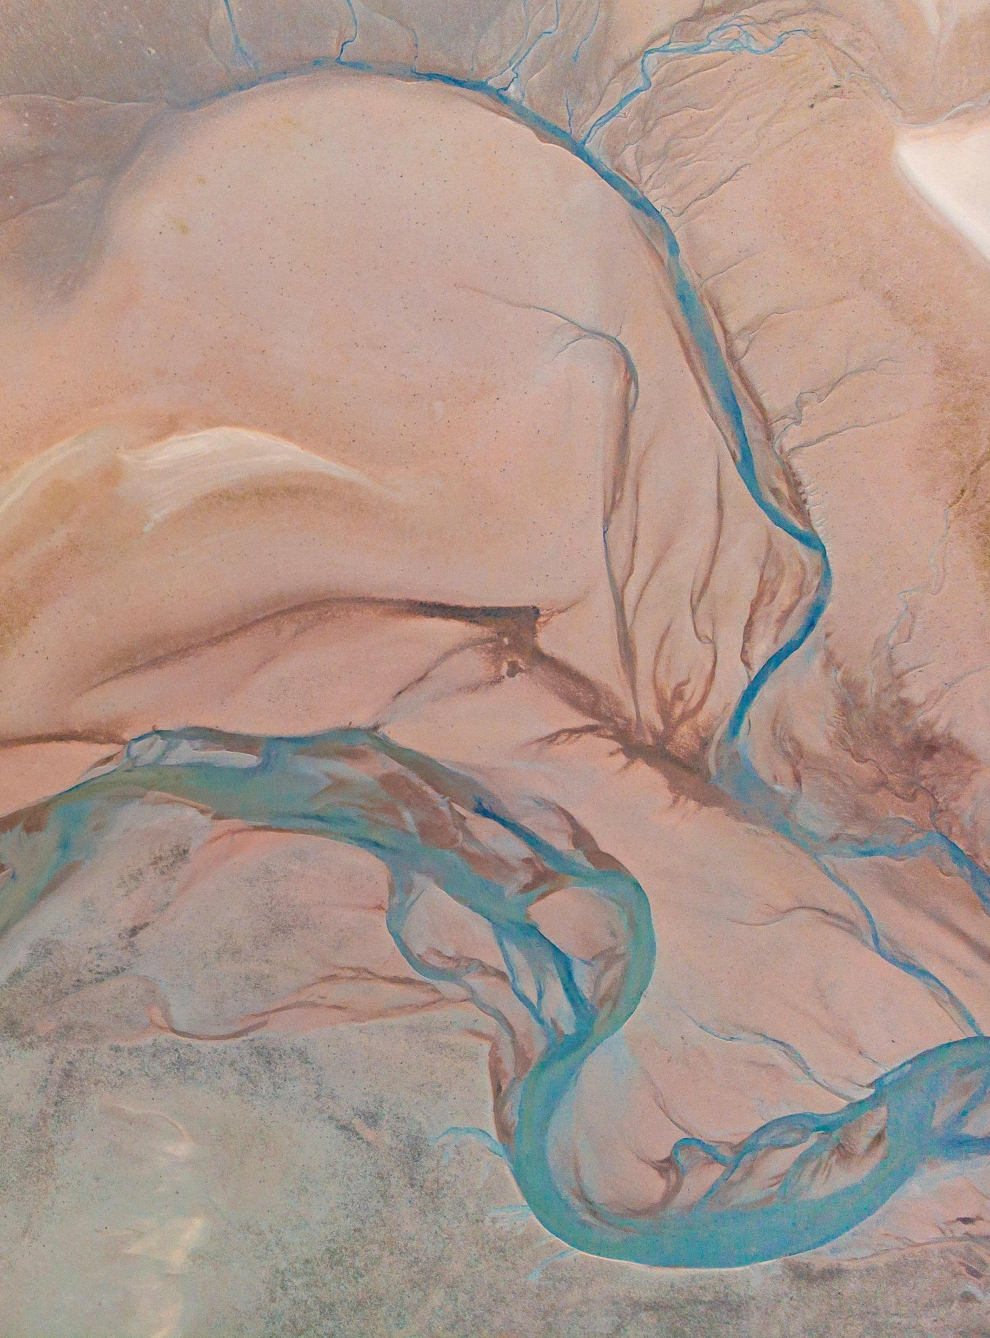
Campsite Commander
Safiya Abdool ST10540572

Slide 2
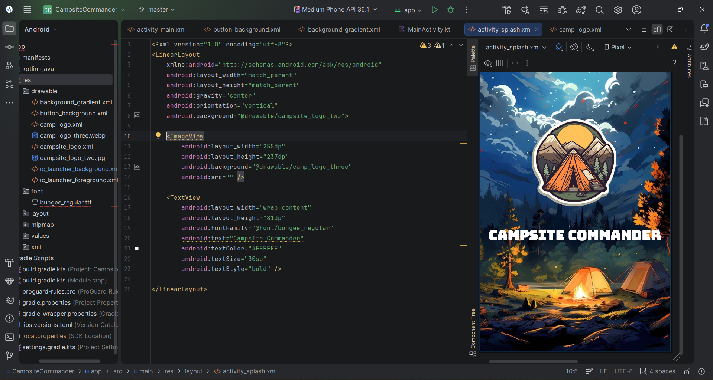
The design of the application was guided by usability principles, user experience (UX), and technical constraints.

Slide 3
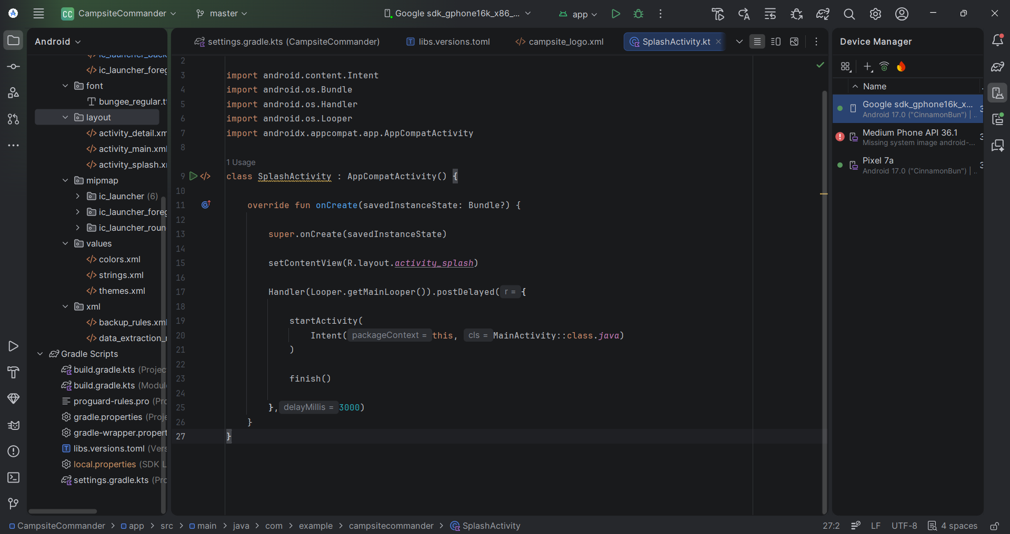
Splash Activity kt

Slide 4
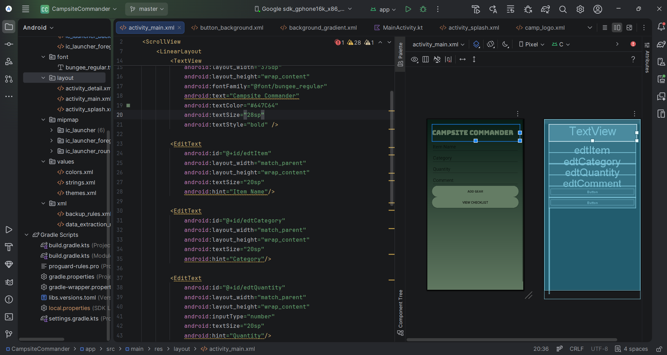
The interface was designed to be simple, intuitive, and accessible: • A clean layout ensures users can focus on questions without distraction • Large buttons improve usability on mobile devices • Readable fonts enhance accessibility • Consistent colour schemes create a cohesive experience Minimalist design principles were applied to reduce cognitive overload and improve navigation efficiency.

Slide 5
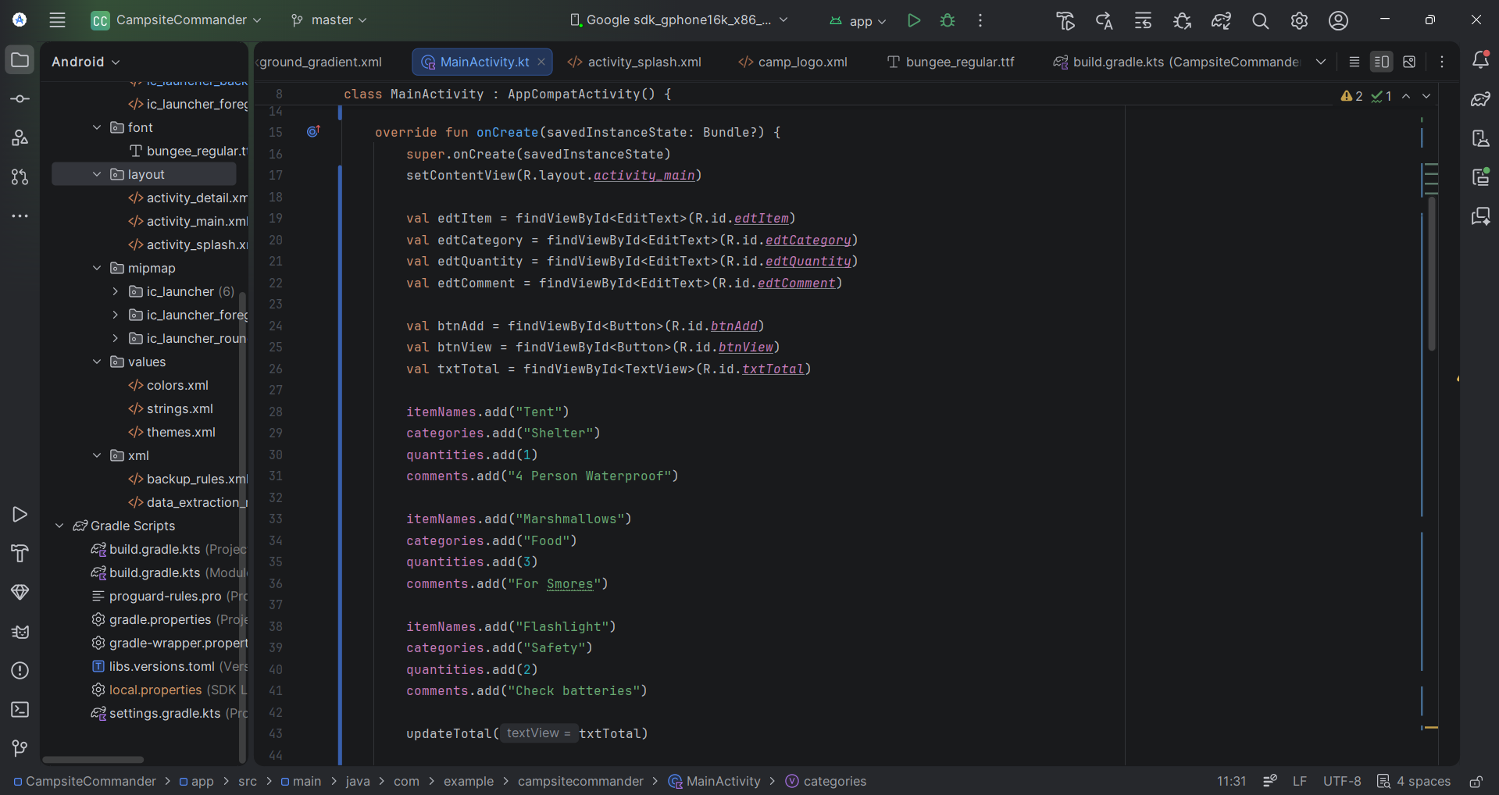
The application logic was implemented using Kotlin: • items are stored in arrays or data structures • A function (e.g., loadQuestion) dynamically updates the UI • User responses are evaluated and stored

Slide 6
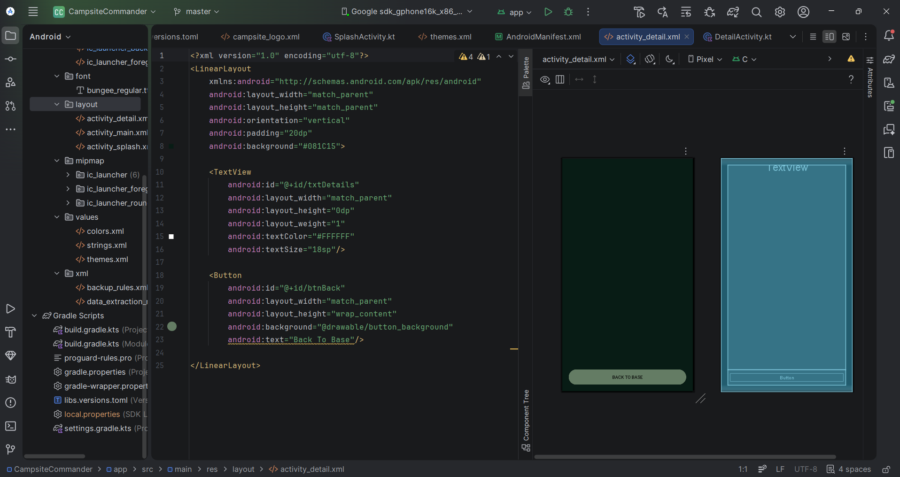
The app follows a linear and predictable flow: 1. Splash screen 2. Main Screen 3. Results/view screen This structure ensures ease of use, even for first-time user

Slide 7
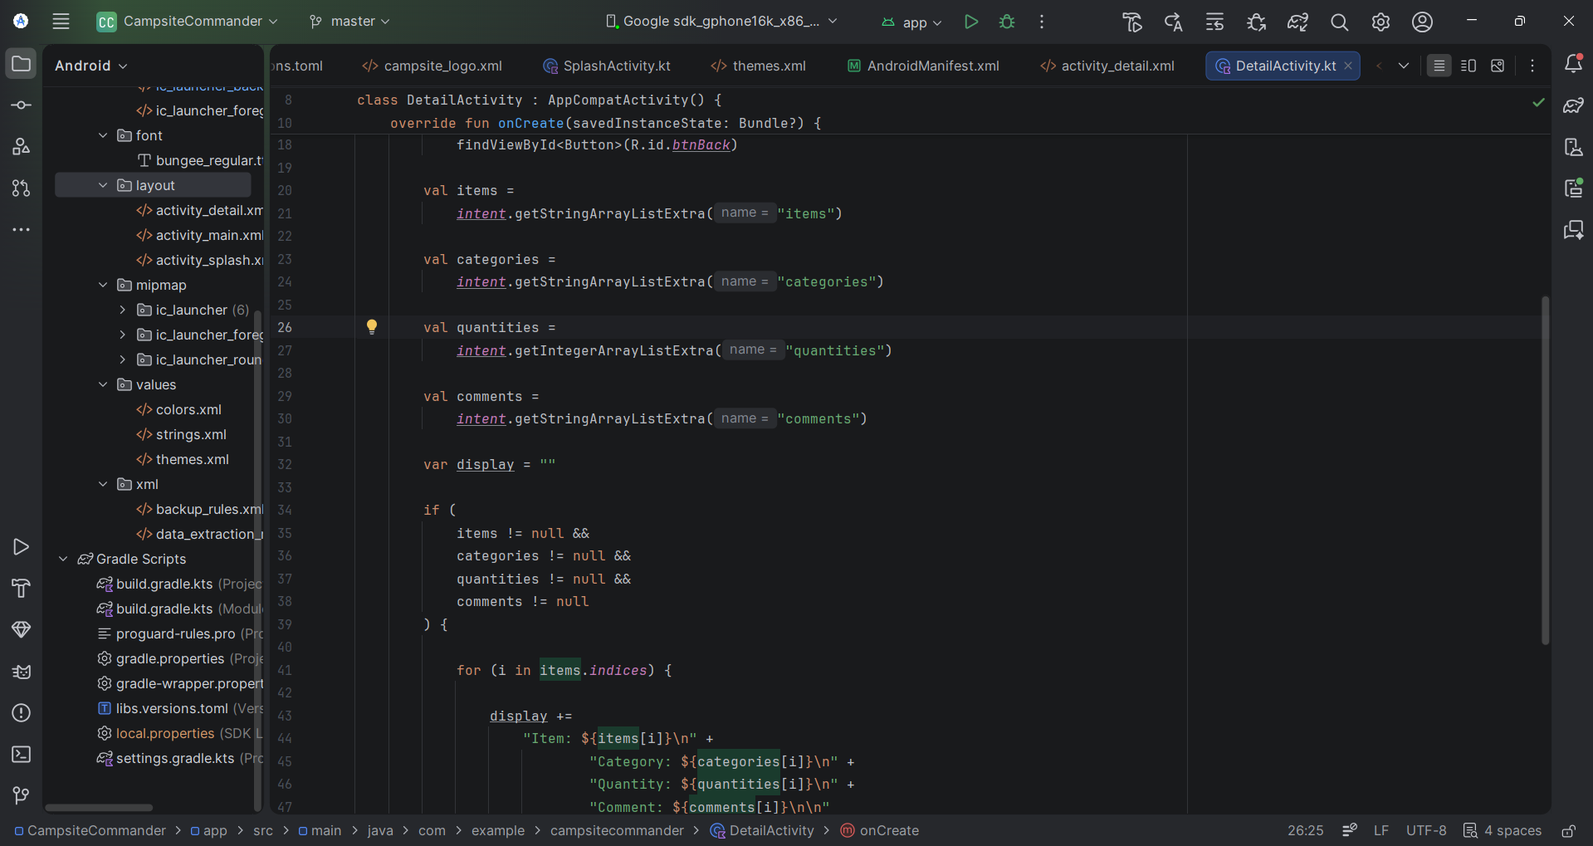
Details activity kt

Slide 8
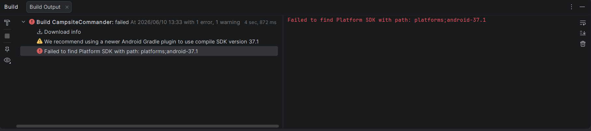
The Campsite Commander app successfully meets its objective of helping campers check their inventory before any outdoor adventures while providing an engaging mobile experience. Through thoughtful design and the use of modern development tools such as GitHub and GitHub Actions, the project demonstrates both technical and practical application development skills. The integration of version control and automation tools ensures maintainability, scalability, and reliability, making the app a strong foundation for future enhancements. While the application has an issue running on android studio you’ll find no errors besides the one above.

Slide 9
Thank you for your interest in campsite commander
LINKS:
GITHUB: https://github.com/IIEVCPMB/exam-practicum-imad5112-gr02-safiyaabdool.git

